Slide 1
State Bans on Lawful Hunting Trophies
Conservation Force
NASC Sportsman-Legislator Summit
December 1, 2016

Slide 2
Conservation Force
501(c)(3) non-profit
World-wide board and staff
Targeted enhancement test permitting, down-listing petitions, legal advocacy, range state advice
Represents the force of sportsmen and sportswomen

Slide 3
Agenda
Pop quiz
ESA 101
State laws that do and don’t restrict trophies
The “Cecil Campaign”
Why it matters → enhancement
The fallout from prohibitive state laws: NJ suit

Slide 5
Example 1
It is unlawful for a person to sell, offer to sell, purchase, trade, barter for, or distribute any covered animal species part or product.
“Covered animal species” means any species of elephant, rhinoceros, tiger, lion, leopard, cheetah, pangolin, marine turtle, shark, or ray.

Slide 6
Example 2
No person shall possess, transport, import, export, process, sell or offer for sale, or ship any specified African species; or any species of elephant, rhinoceros, tiger, lion, leopard, cheetah, pangolin, marine turtle, or ray.
“Specified African species” are African elephant, leopard, lion, black rhinoceros, and white rhinoceros.

Slide 7
The Endangered Species Act (1973)

Slide 8
Section 9 Prohibitions (16 U.S.C. § 1538)
Import
Export
Take
Sale and related commercial acts

Slide 9
Section 10 Exceptions (16 U.S.C. § 1539)
(a) PERMITS.—(1) The Secretary may permit, under such terms and conditions as he shall prescribe— (A) any act otherwise prohibited by section 9 … to enhance the … survival of the affected species …

Slide 10
Section 6 Cooperation with the States (16 U.S.C. § 1535(a))
(a) GENERAL.—In carrying out the program authorized by this Act, the Secretary shall cooperate to the maximum extent practicable with the States.

Slide 11
Section 6 Preemption (16 U.S.C. § 1535(f))
(f) CONFLICTS BETWEEN FEDERAL AND STATE LAWS.—Any State law or regulation which applies with respect to the importation or exportation of … endangered species or threatened species is void to the extent that it may effectively (1) permit what is prohibited by this Act or by any regulation which implements this Act, or (2) prohibit what is authorized pursuant to an exemption or permit provided for in this Act or in any regulation which implements this Act….

Slide 12
State Laws that Do and Don’t Restrict Lawful Hunting Trophies

Slide 13
DO
Prohibit personal uses (e.g., import, transport, possession)
Target “Big Four” or “Big Five” species
Contain no exception for federally authorized acts
*Caveat – focus on ESA, not other conflicts
DO NOT
Prohibit commercial uses (e.g., sale, offer for sale, distribution)
Target trafficked species like pangolin, sharks, rays
Contain an exception for federally authorized acts

Slide 14
DO
New Jersey (S977 & S978)
New York (S6072)
Connecticut (S227)
DO NOT
Washington (Initiative 1401)
Oregon (Measure 100)
Hawaii (S2467)

Slide 15
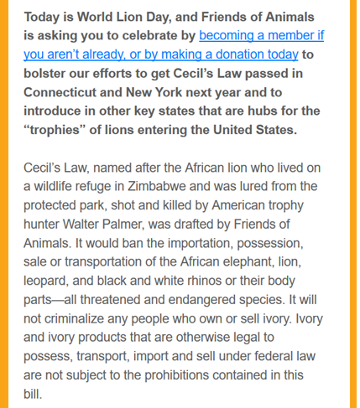
The Cecil Campaign

Slide 16
Anti-hunting activists seek to ban lawful hunting trophies …
Why does it matter?
ESA § 10: permits are issued when the activity “enhances the survival of the species”
So banning lawful trophies blocks the enhancement – the benefits – for listed species

Slide 17
Enhancement: Black rhino trophies from Namibia

Slide 18
Enhancement: Tanzania Lion Contributions

Slide 19
The Fall-Out of State Trophy Bans: New Jersey Suit

Slide 20
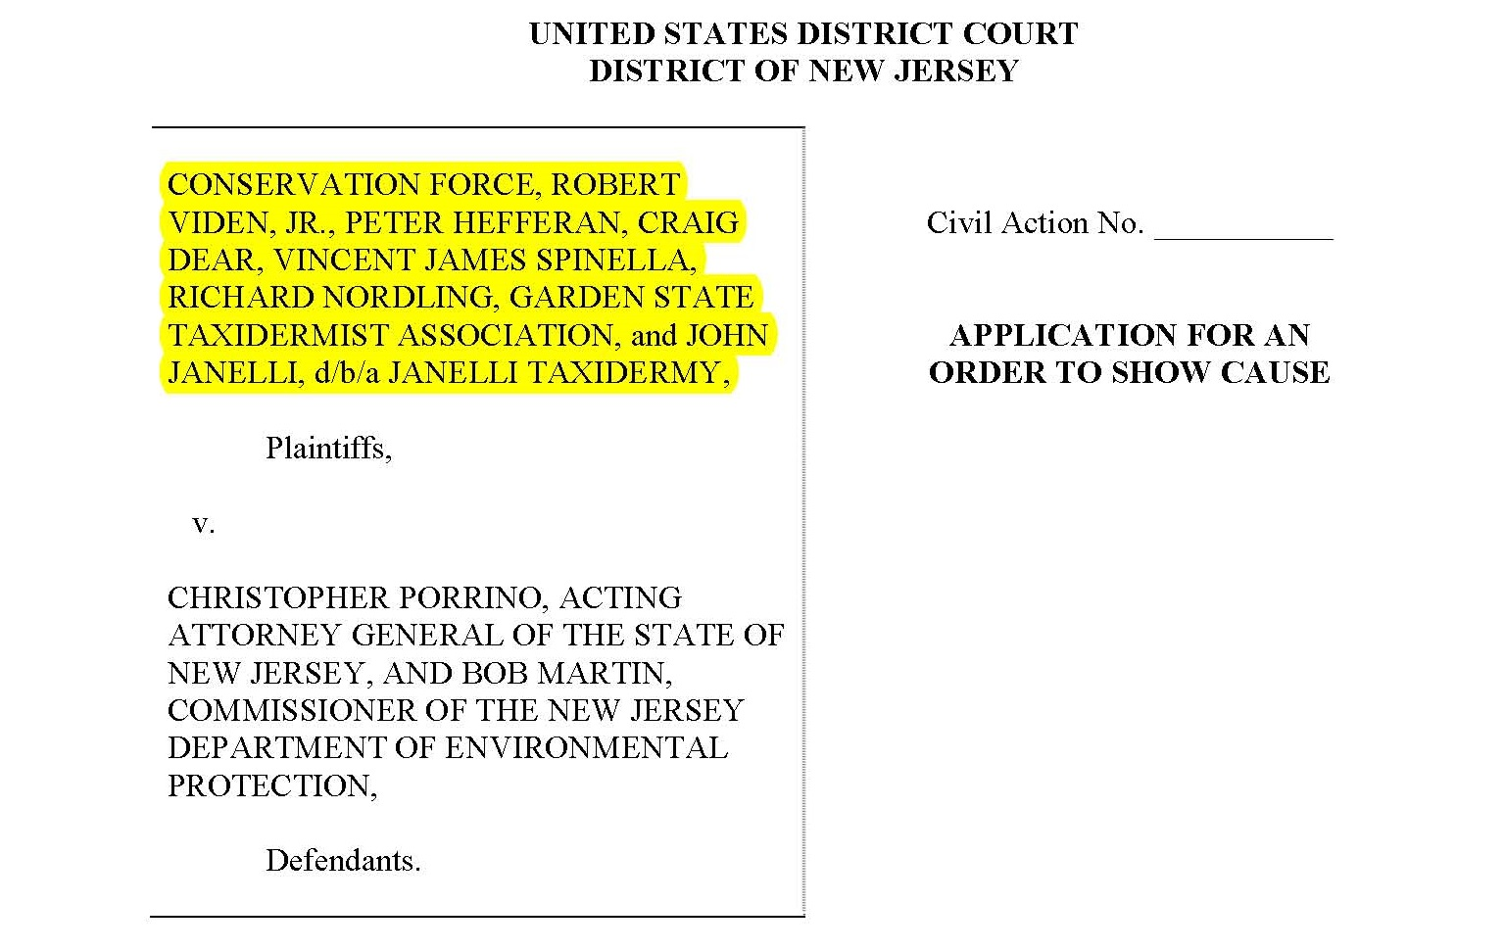

Slide 21
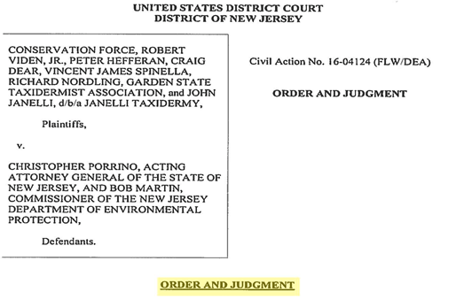
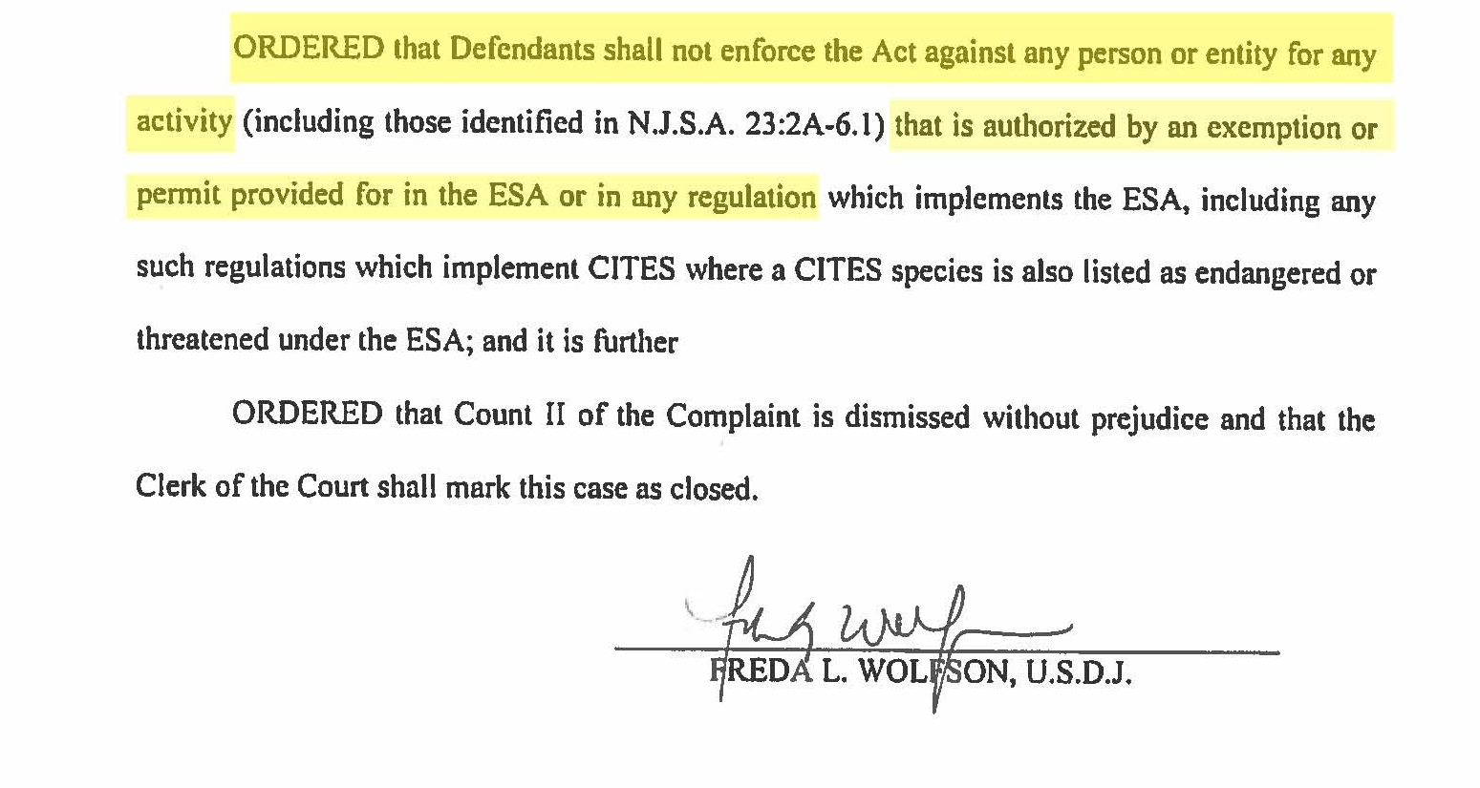

Slide 22
New Jersey Suit
Conservation Force led 8 plaintiffs and 2 declarants in challenging S977 under the Supremacy Clause and 42 U.S.C. § 1983; noticed claim under the ESA
Defendants conceded on p. 1 of their Opposition that they could not enforce S977 against federally authorized imports/possession of lawful trophies
The parties are now litigating plaintiffs’ claim for fees

Slide 23
Take-Aways
State bans on lawful trophies are unlawful under the ESA
State laws should consider exception for federally authorized activities
States should consider the “enhancement” recognized by federal permits
More information: www.conservationforce.org regina.lennox@conservationforce.org

